Slide 1
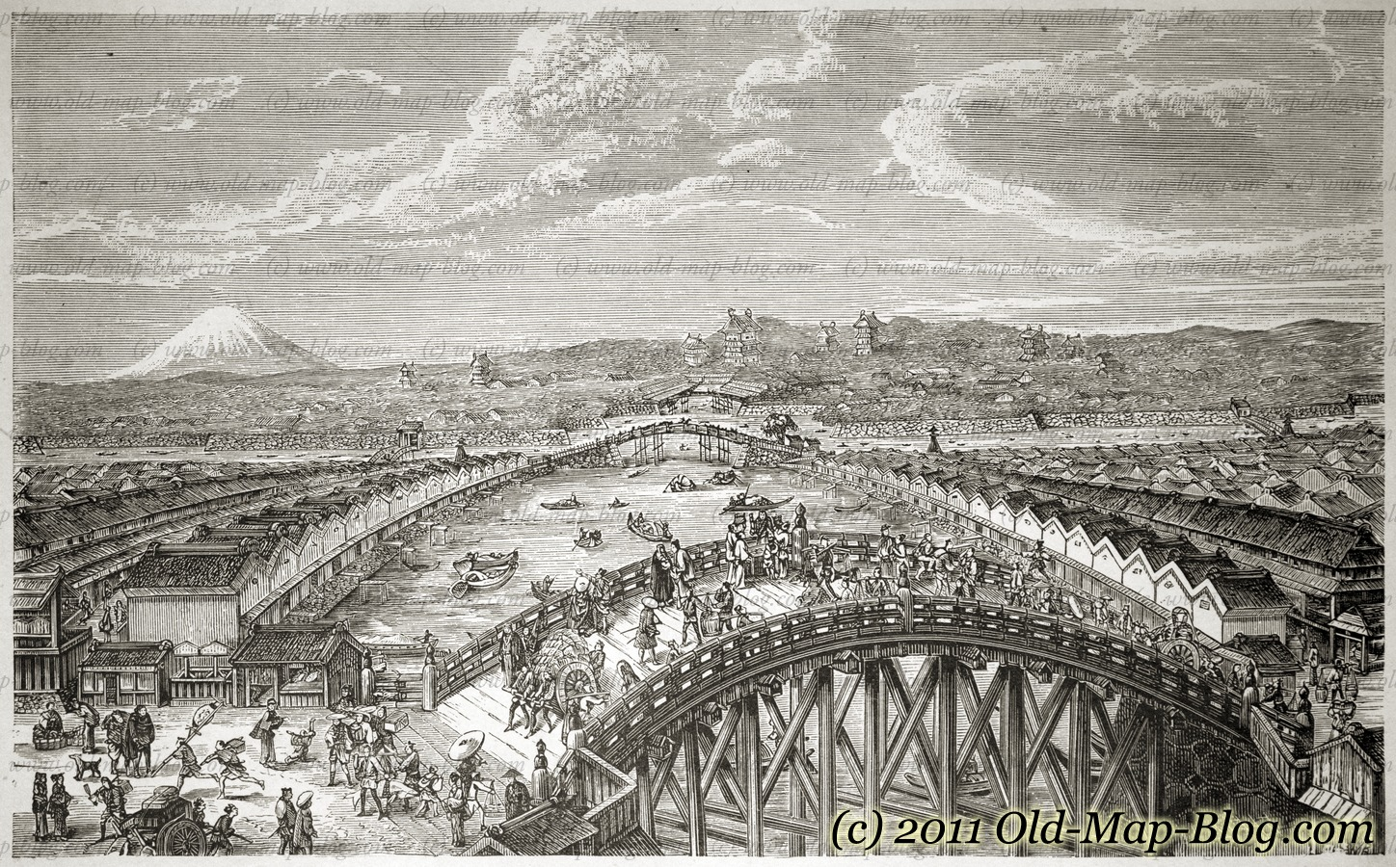

s
FOREIGN TRADE UNDER
THE
BRITISH RULE...

Slide 2
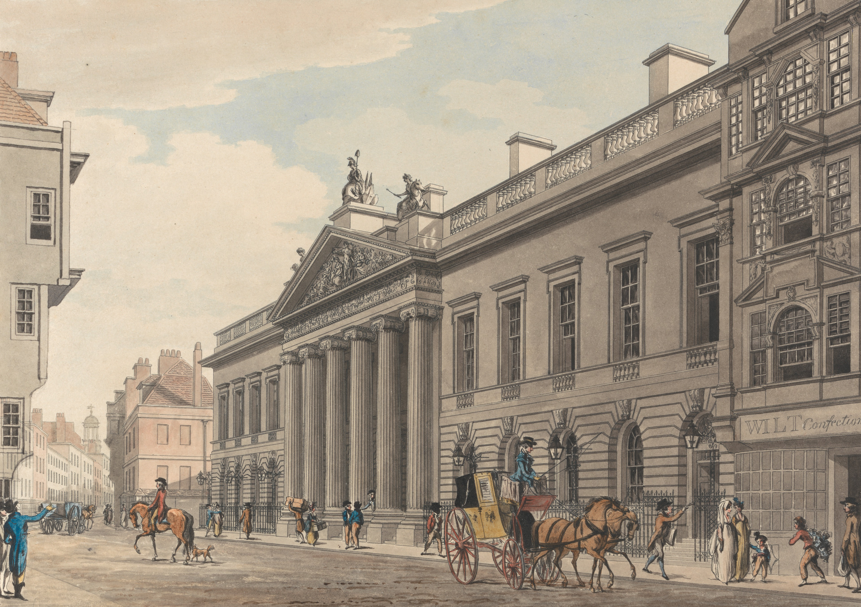
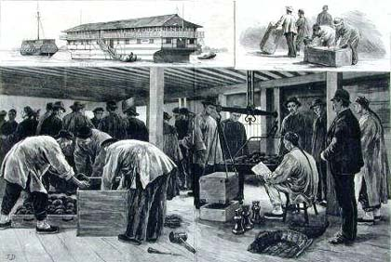
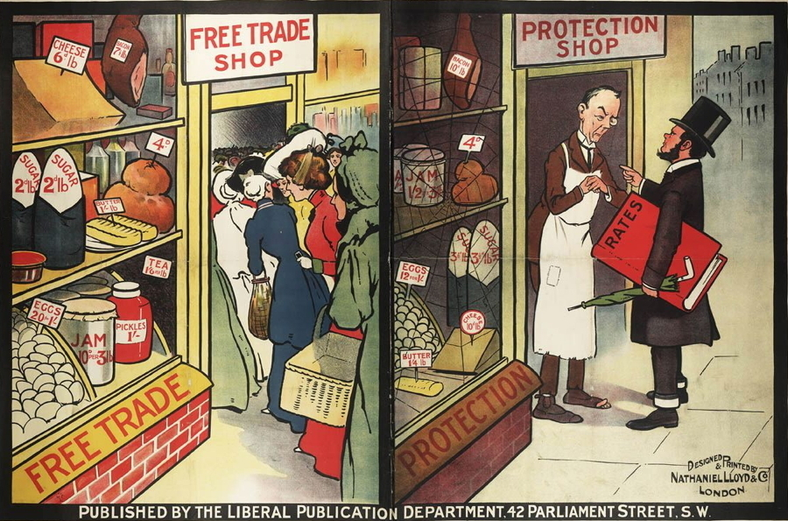
India was a well known exporter of finished goods
But the British converted India into a net exporter of raw material and importer of finished goods
Different policy of trade and tariff pursued by the British Government

Slide 3
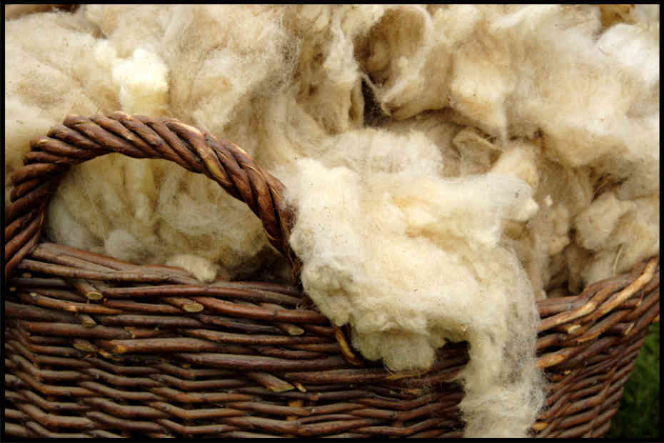
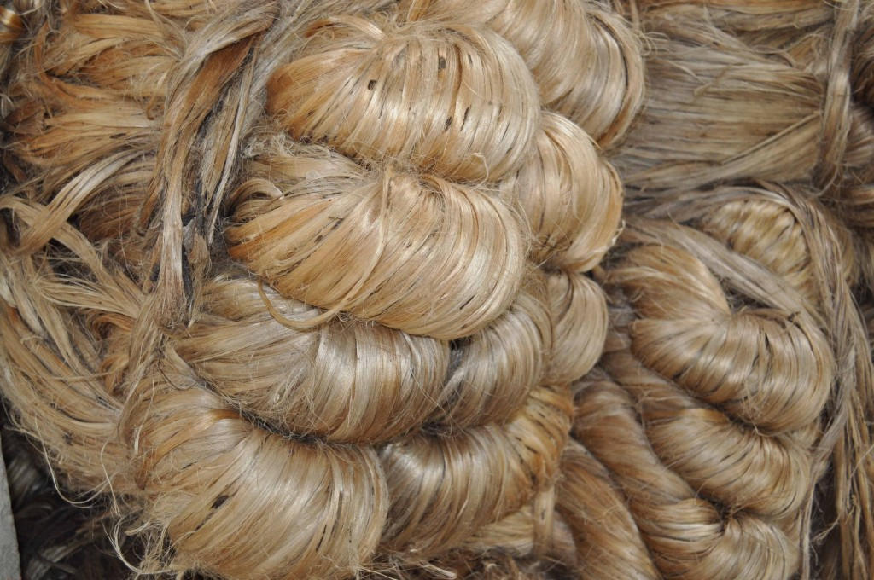


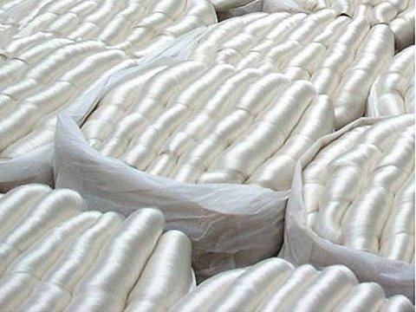
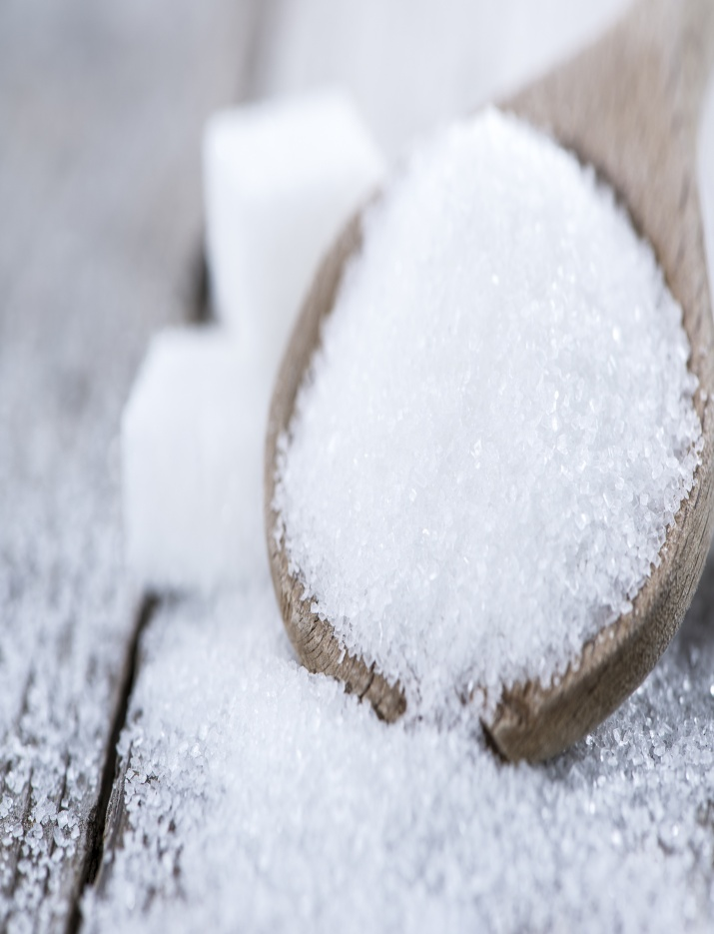
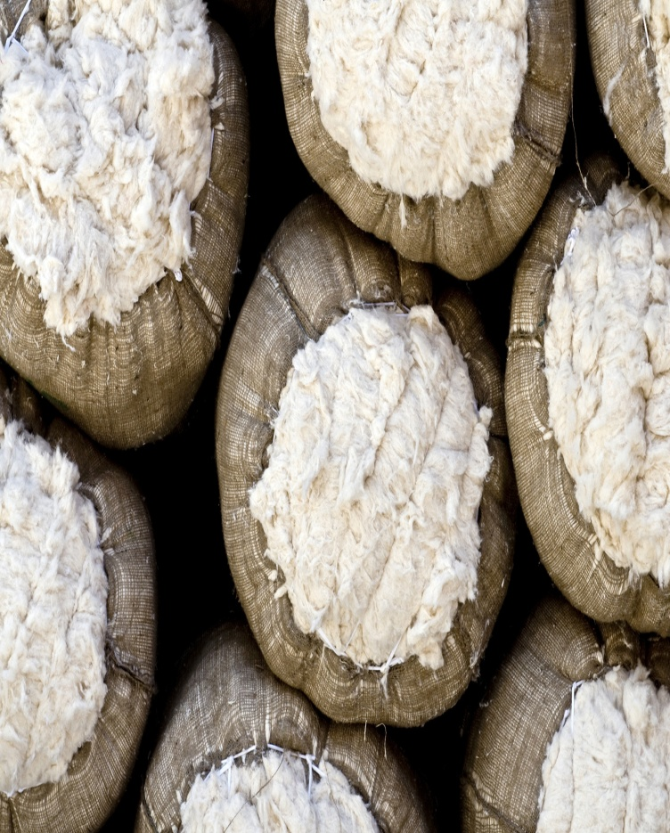
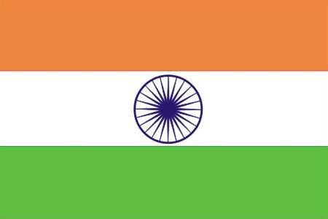
India become net exporter of raw materials and primary products
BRITISH
INDIA
On the other hand it became net importer of finished goods produced by the British industry

Slide 4
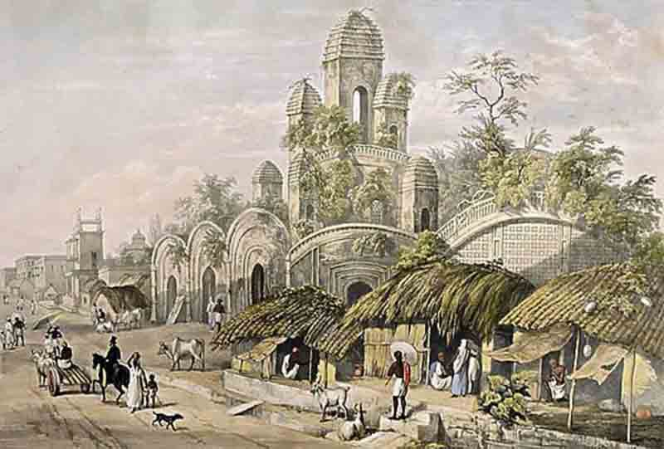
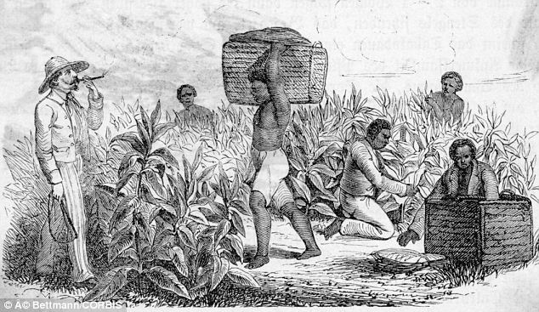
COMPOSITION OF EXPORTS AND IMPORTS REFLECTED UTTER BACKWARDNESS OF THE INDIAN ECONOMY

Slide 5
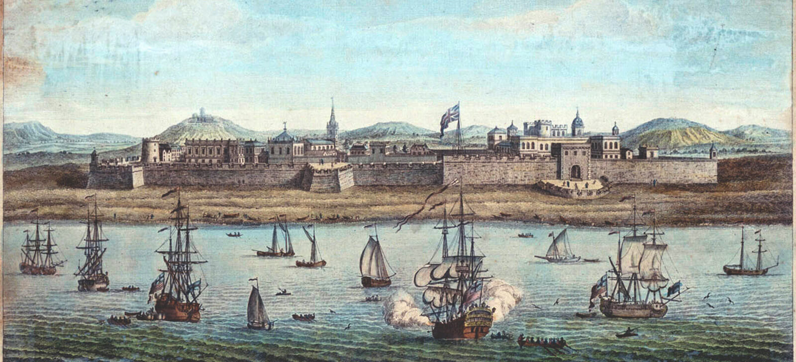
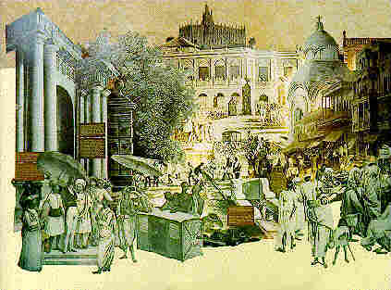
Since India was ruled as a British colony, export and import of the country became under monopoly control of the British government.
More than 50% of India's foreign trade was directed towards Great Britain.
While exports of primary products from India supplied inputs to the British Industry; imports of finished goods from Britain provided a huge market to the British Industry.
THESE ARE TYPICAL CHARACTERISTICS OF A BACKWARD ECONOMY.

Slide 6
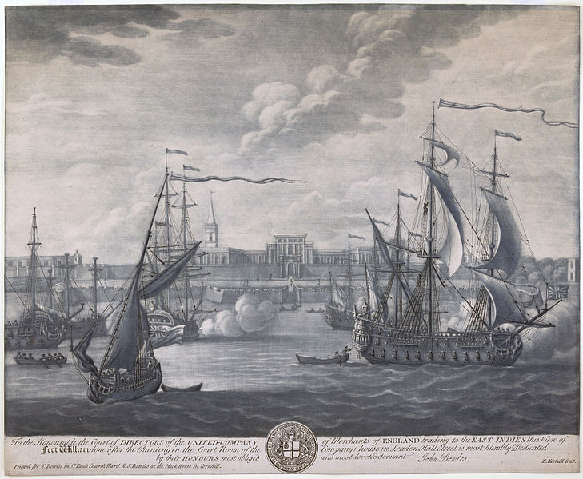
India before British raj
Exported Finished Products (Cotton, Silk Textiles, Irony Works ect.
India after British raj
Exported Raw materials
Imported Finished goods.
Backwardness And Stagnation

Slide 7
CONCLUSION…….!!!!!!
SURPLUS GENERATED AS BALANCE OF TRADE WAS ONLY SPENT TO MEET ADMINISTRATIVE AND WAR EXPENSES BY THE BRITISH GOVERNMENT IN INDIA .IT WAS USED ONLY TO ENHANCE COLONIAL PURSUITS OF THE BRITISH GOVERNMENT .IT WAS NEVER USED AS INVESTMENT FOR FUTURE GROWTH.CONSEQUENTLY ,POVERTY AND BACKWARDNESS WAS ELEVATED

